Slide 1
0x301 – What Security Gives Us
ECED4406 – Computer Security
Dr. Colin O’Flynn
Dalhousie University.

Slide 2
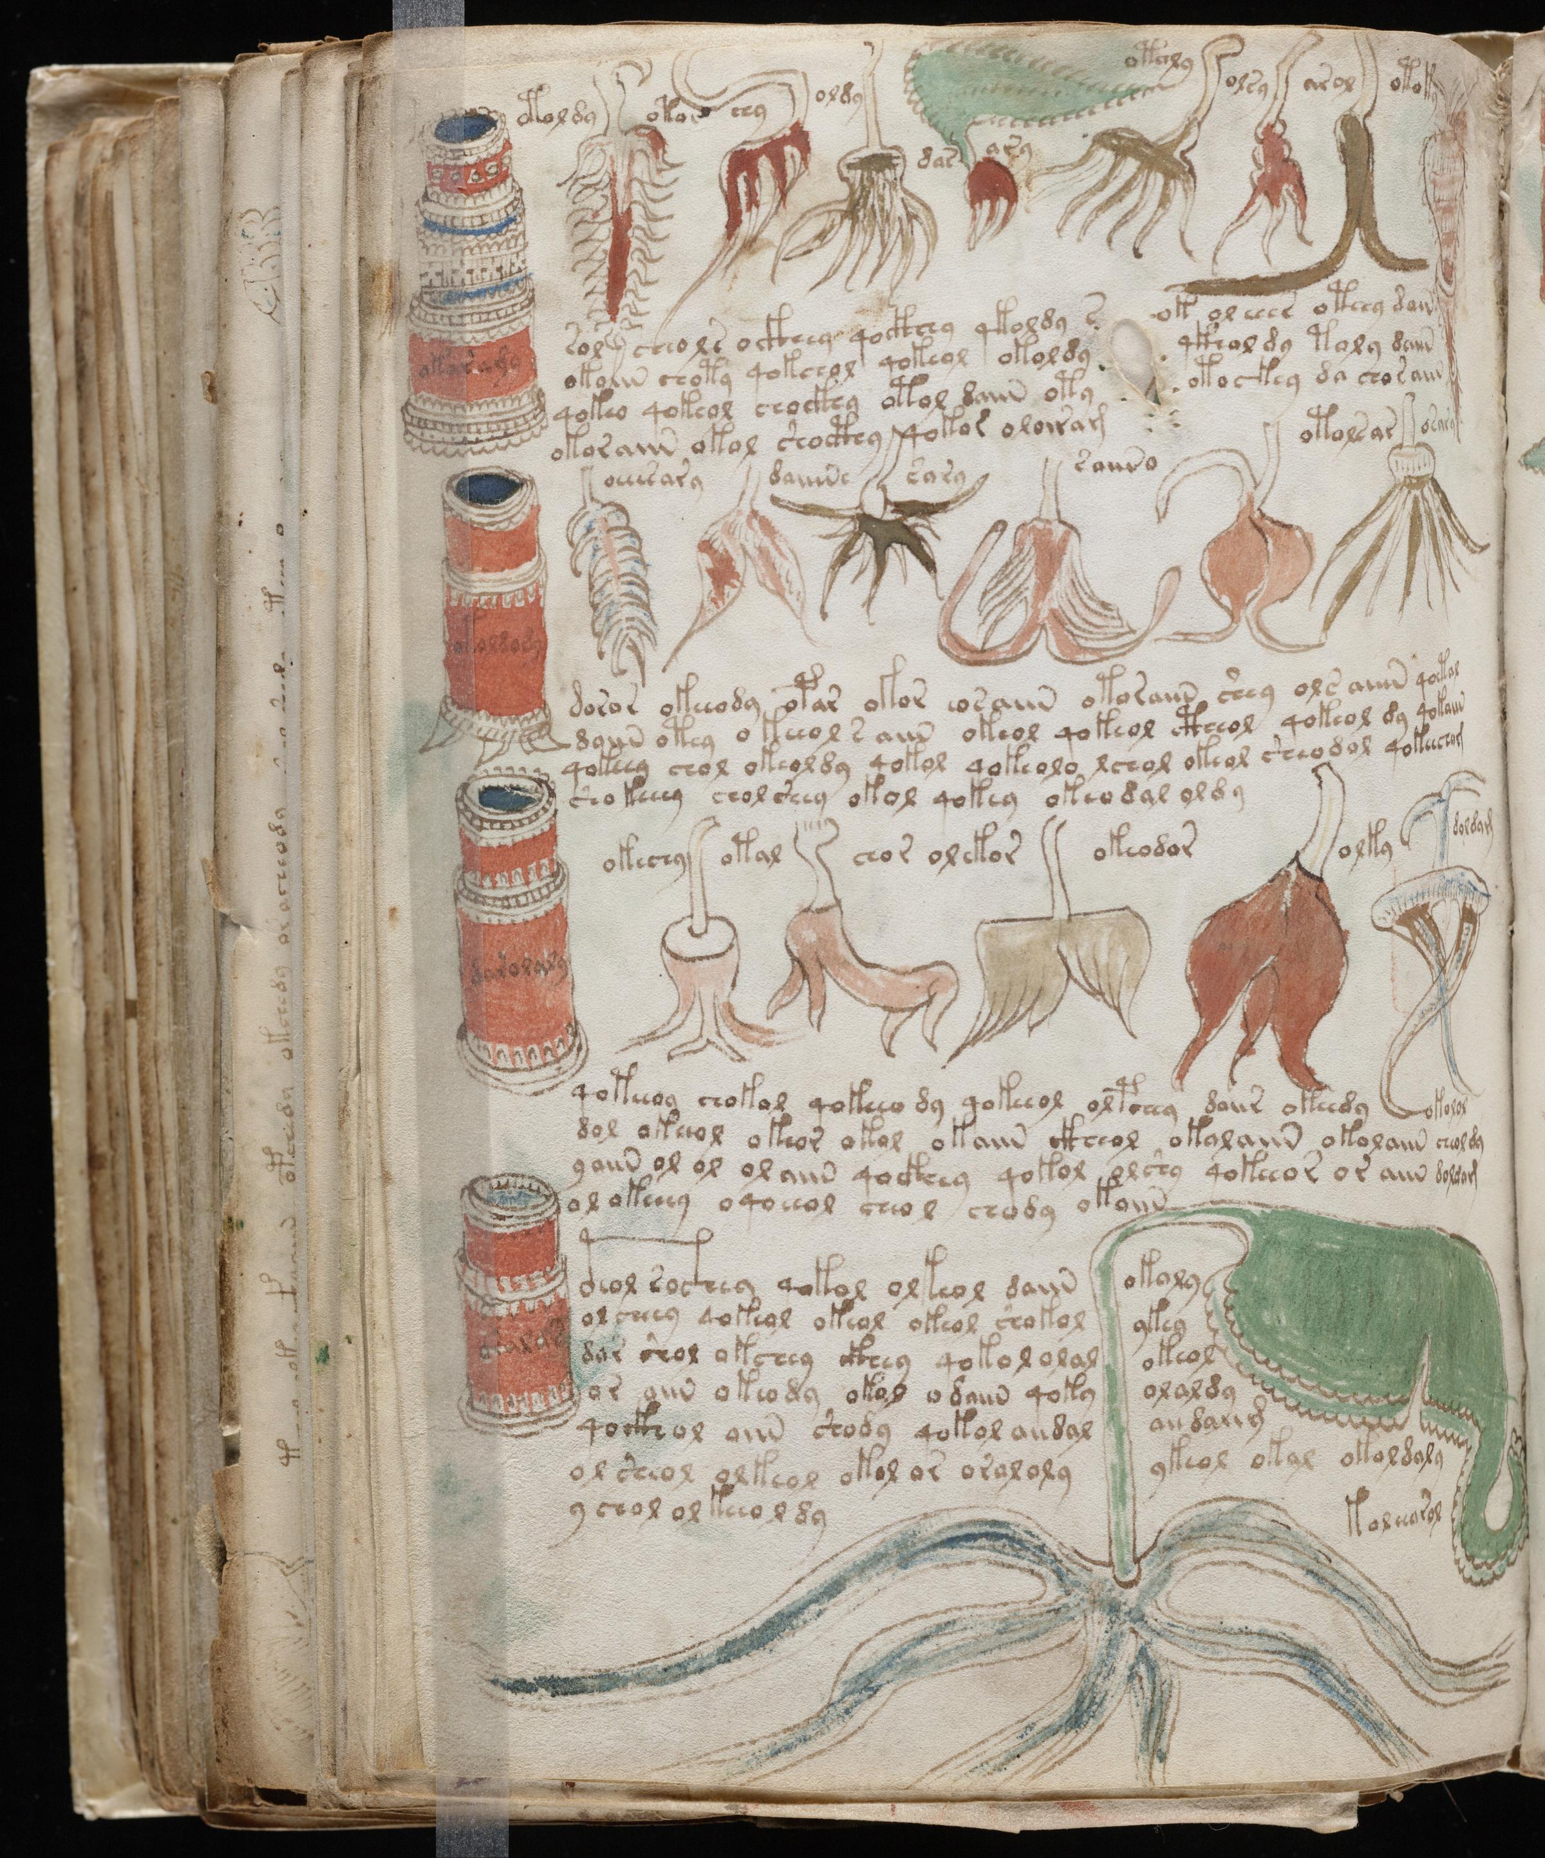

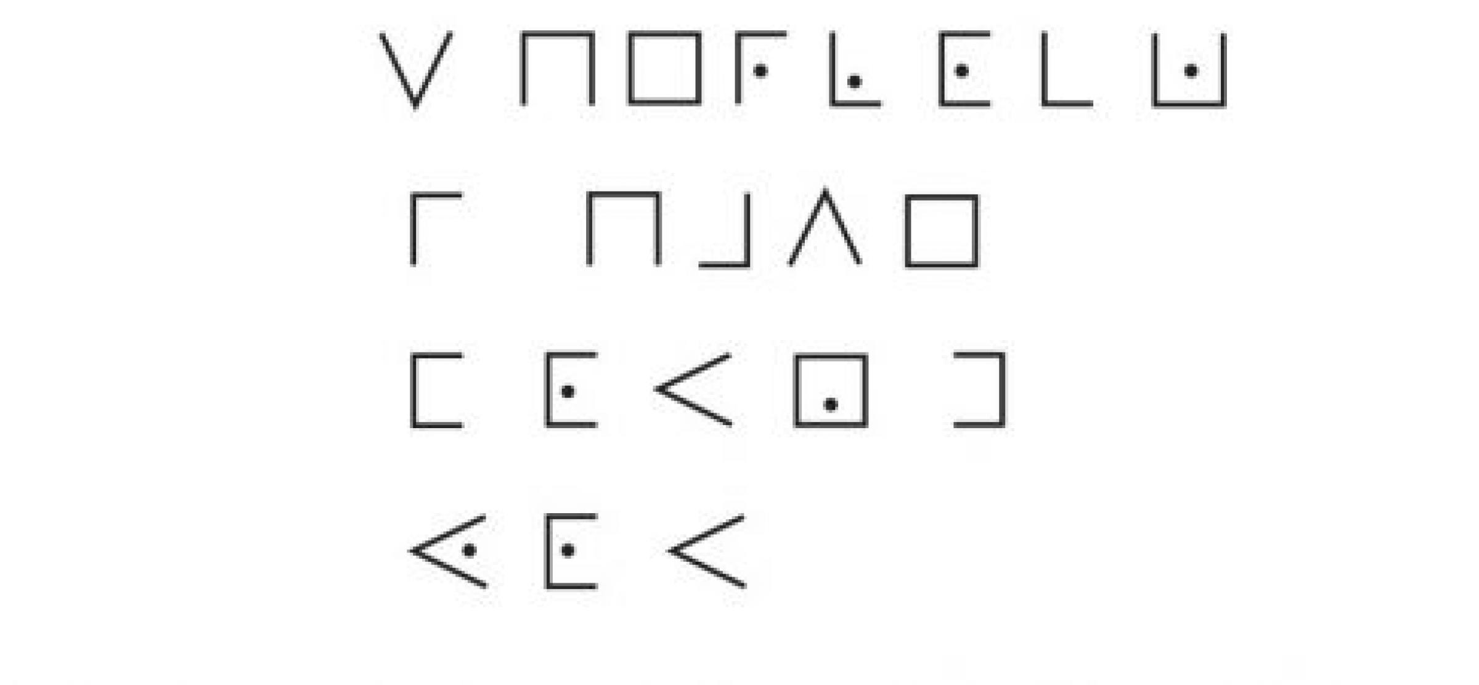
Confidentiality
Probably what you think of with “security”. Prevents someone from reading your messages.

Slide 3
Integrity
Data protected by unauthorized modifications.
We can have integrity without confidentiality.

Slide 4
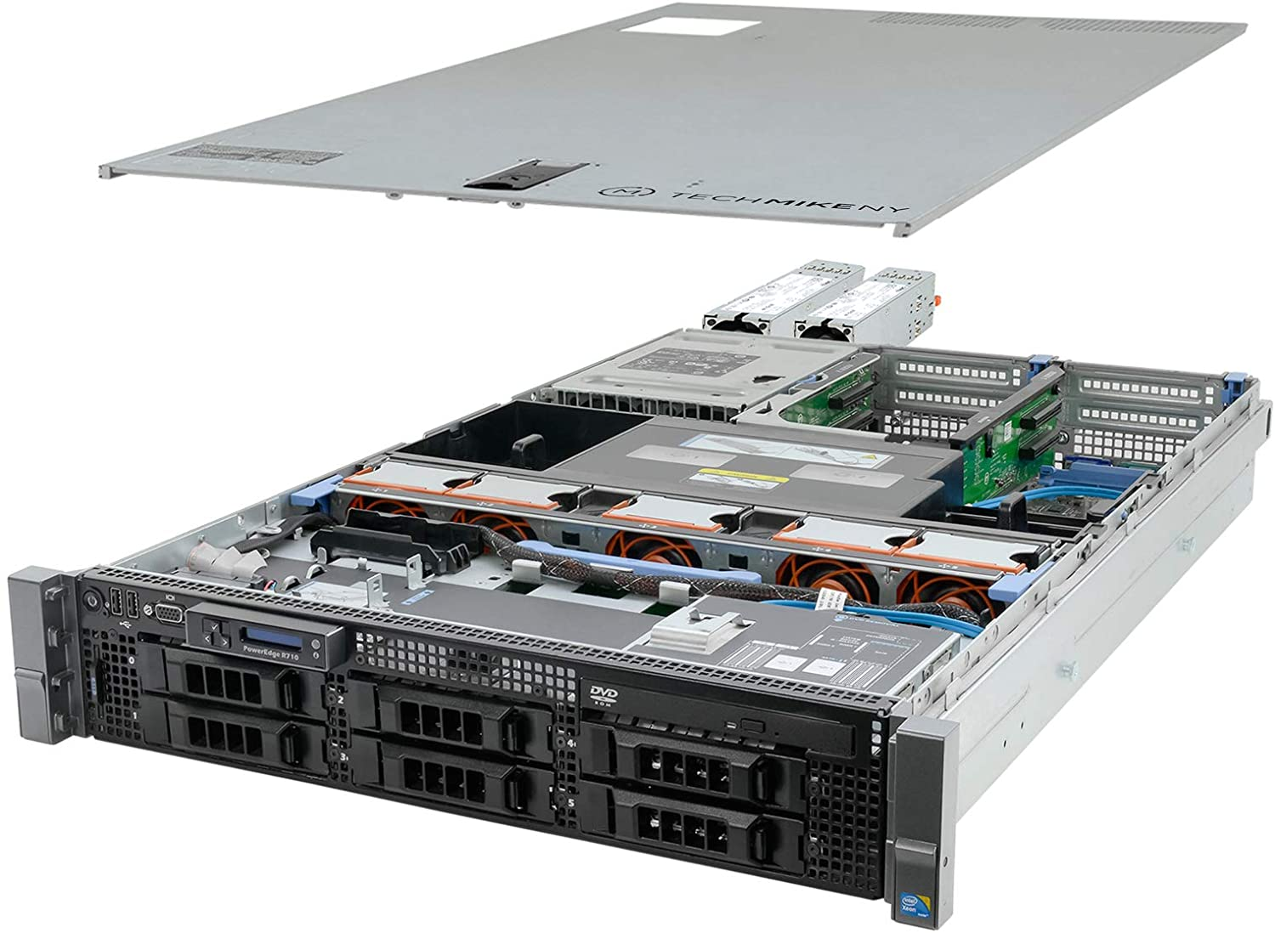
Availability
System should remain available for user.
Unhackable server (not plugged in).
Cryptography isn’t concerned with availability, but often a critical part of overall security.

Slide 5
Non-repudiation
Cannot deny later having sent messages that you sent.
Often a complex question – can
you claim someone stole the secret
key you use?

Slide 6
Property 1: Confidentiality
Confidentiality alone has a problem:
Attacker can modify information without needing to know the contents.
Attack the fort at dawn.
Meet me at nightfall by the tower.
Jccjlt cqn oxac jc mjfw.
Vnnc vn jc wrpqcojuu kh cqn cxfna.

Slide 7
Jccjlt cqn oxac jc mjfw.
Vnnc vn jc wrpqcojuu kh cqn cxfna.
Jccjlt cqn oxac jc wrpqcojuu kh cqn cxfna.
Attack the fort at nightfall by the tower.

Slide 8
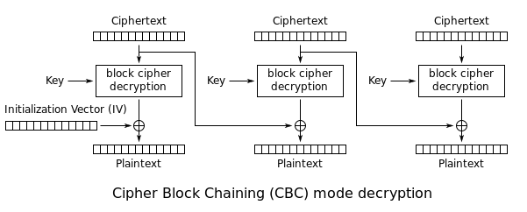
“Real” Example: AES-CBC Attack
We’ll be coming back to what AES is – but this figure shows the flow. Assume attacker has ciphertext (encrypted data) access only.

Slide 9
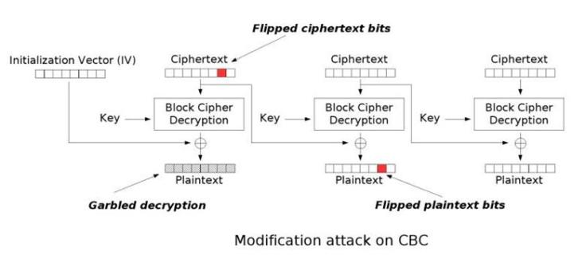
Flipping a bit here…

Slide 10
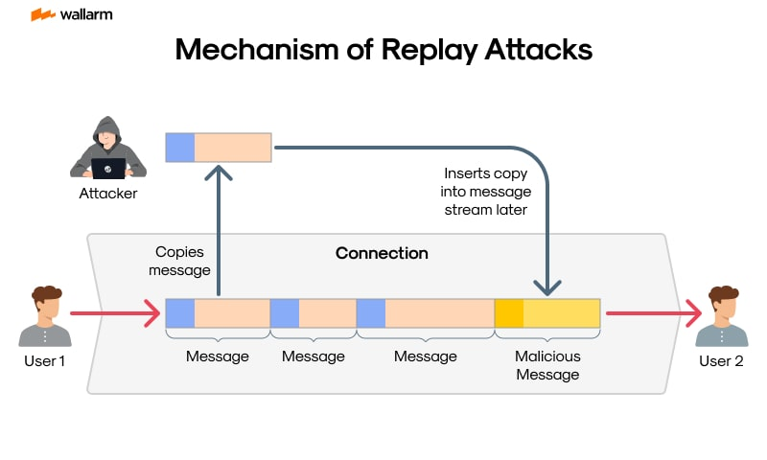
Attacks on Confidentiality: Replay Attacks

Slide 11
Attacks on Confidentiality: Replay Attacks

Slide 12
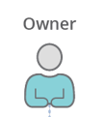

e.g., Replay Attacks on Wireless Devices

Slide 13
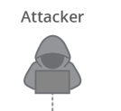
e.g., Replay Attacks on Wireless Devices

Slide 14
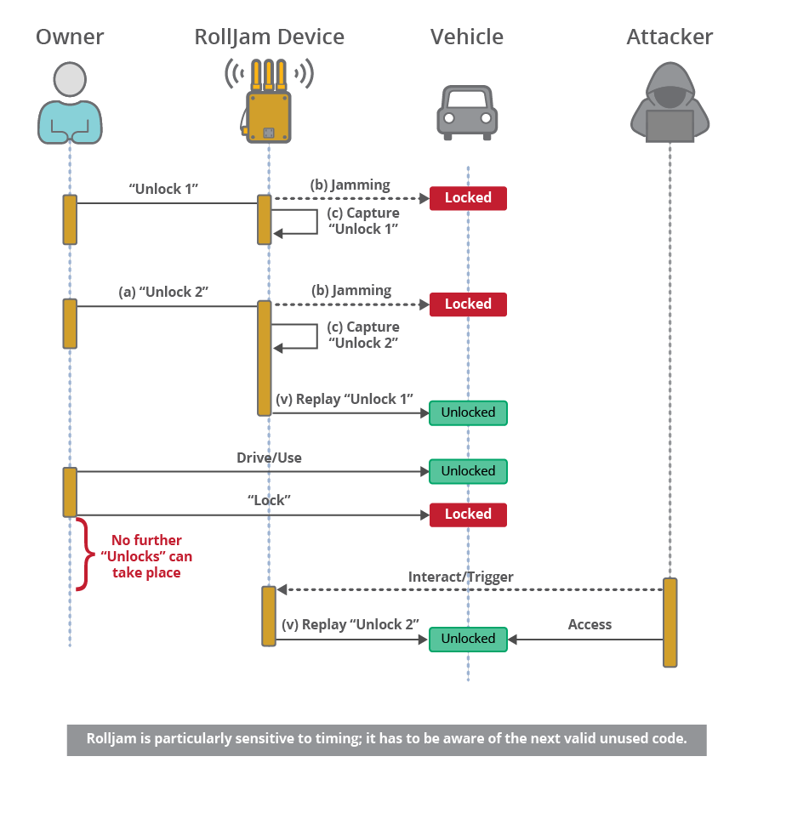
https://www.sei.cmu.edu/blog/radio-frequency-101-can-you-really-hack-a-radio-signal/

Slide 15
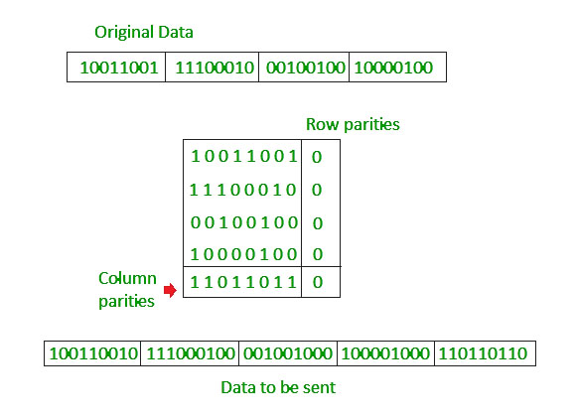
Property 2: Integrity
Data protected by unauthorized modifications.
WARNING: There is a difference between integrity in communications / electronics context & integrity in security / cryptography context!
Common checksums, CRCs, parity checks, etc often use reversable algorithms, or very short lengths.
An attacker may be able to modify the file in such a way the same checksum is generated.
Thus a checksum, CRC, and other common techniques are not cryptographic integrity checks.

Slide 16
Simple Checksum Example
I’m sending you a large file by mail – I tell you over the phone (our secure channel) the checksum should be 938229. The file is far too long to tell you the contents over the phone.
You run a simple checksum program, such as:
uint32_t checksum = 0;
for (int i = 0; i < file_length; i++)
{
checksum += file[i];
}
printf("%d\n", checksum);

Slide 17
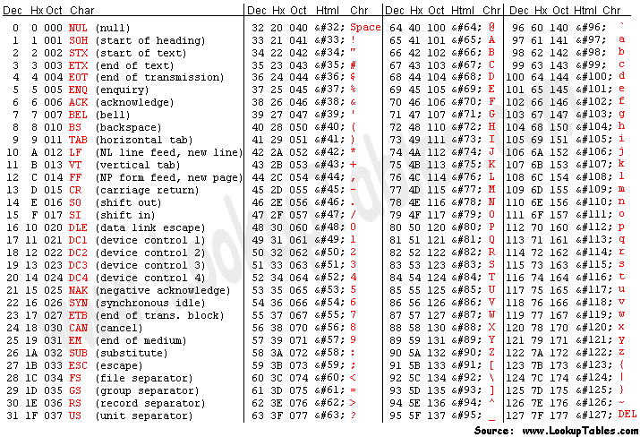
Simple Checksum Hacking Example
= 864
“I hate Tor” → 73 + 32 + 104 + 97 + 116 + 101 + 32 + 84 + 111 + 114
“I love Tom” → 73 + 32 + 108 + 111 + 118 + 101 + 32 + 83 + 97 + 109
= 864
test = "I hate Tor”
csum = 0
for c in test:
print(ord(c))
csum += ord(c)
print(csum)

Slide 18
Cryptographic Integrity → Hash
A hash is cryptographically derived from some data we need to verify the integrity of.
The hash functions cannot be reversed.
An attacker would need to calculate the entire hash and brute force figure out how to change parts of the message.
Examples of Hashes:
SHA-1
SHA-2 (SHA-256)
MD5

Slide 19
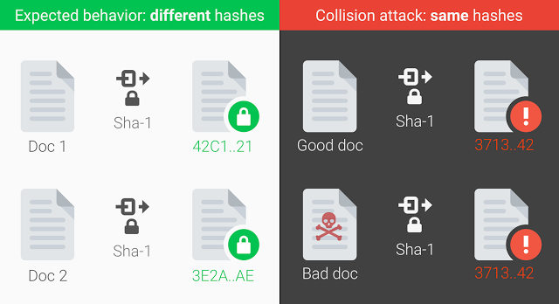
Attacks on Integrity: Hash Collision
A “collision” occurs when two data sources produce the same “hash”.
Collisions are always possible, as the hashes are much much smaller than the files (that is the point of them).
i.e., file may be 1 GB, hash is 32-bytes.
A hash makes it computationally infeasible to figure out a hash.

Slide 20
SHA-1 Hash Collision
In 2017 team at CWI Amsterdam + Google performed such a collision attack, using an algorithm much faster than brute force (100000x faster).
SHA-1 (at the time still ‘trusted’) uses 160 bits.
9,223,372,036,854,775,808 SHA1 computations.
6500 years of single-CPU time, or 110 years of Single GPU time.
Google had many many GPUs/CPUs to throw at this…
https://shattered.io/

Slide 21
Authentication + Integrity
Integrity relies on the hash of a file.
A hash is derived from a file, and allows us to send a file over “untrusted” methods.
End user can confirm the hash matches.
But… how can we get that hash to someone?
Why not transfer the entire file using this “secure channel” if we have it?
Quick example of why: you phone your friend – you could read a hash to them, but you cannot read 100GB file to them.

Slide 22
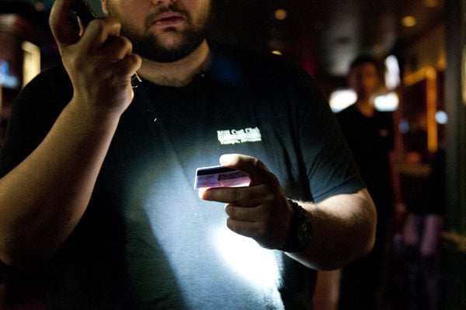
Attacks on Integrity: TOC/TOU
Time of Check / Time of Use
Relies on some distance between a check of a property and the resulting use.
Often on embedded system we take advantage of lack of lots of memory.

Slide 23
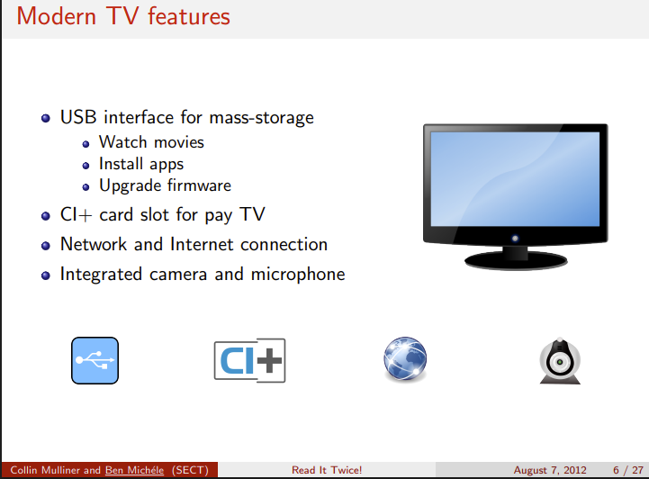
TOC/TOU in Real Life
Following example from:
https://www.usenix.org/sites/default/files/conference/protected-files/michele_woot12_slides.pdf
https://www.usenix.org/conference/woot12/workshop-program/presentation/mulliner

Slide 24
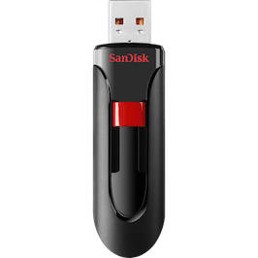
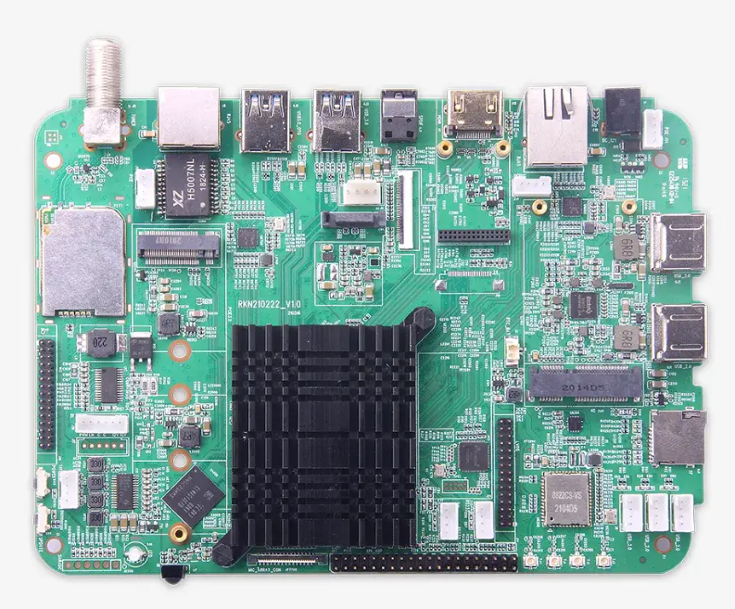
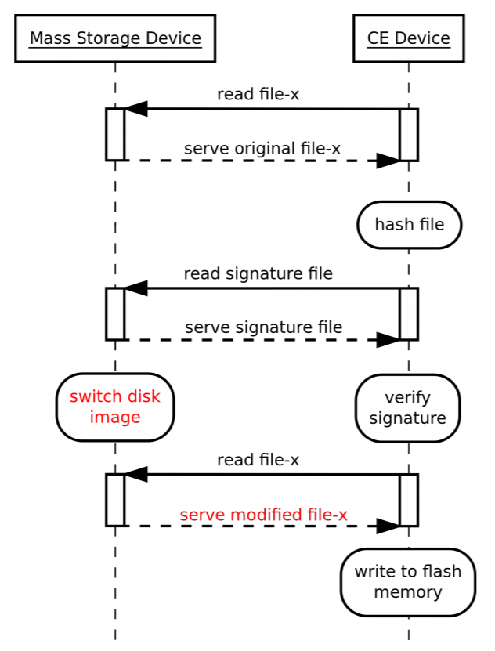

Slide 25
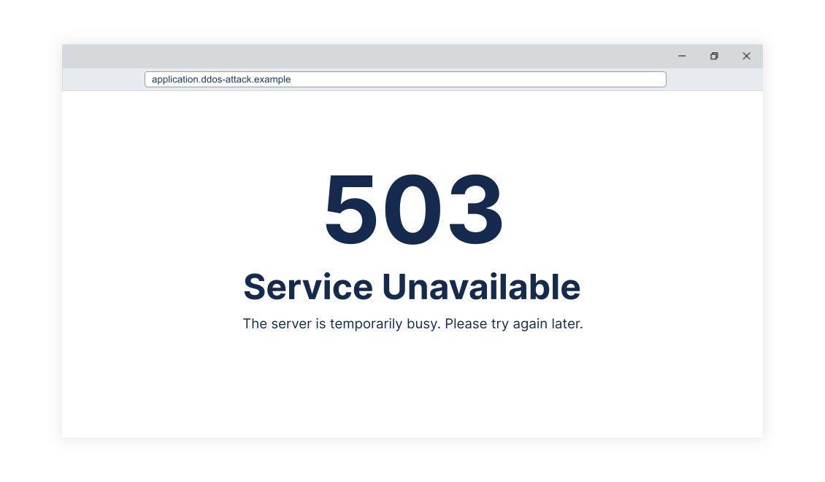
Property 3: Availability

Slide 26
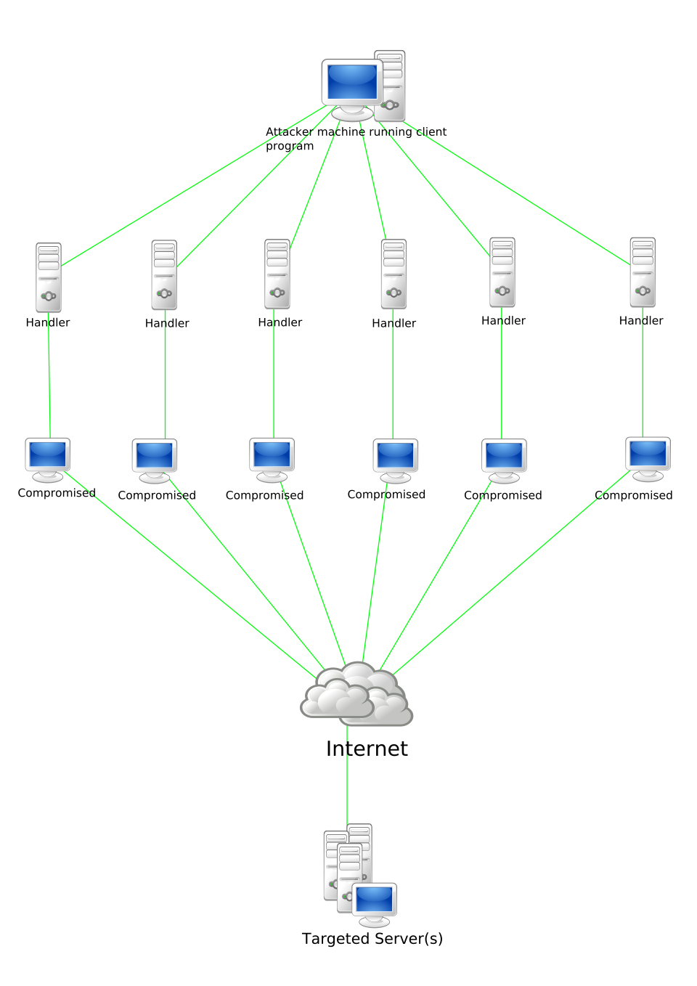
Distributed Denial of Service (DDoS) Attack

Slide 27
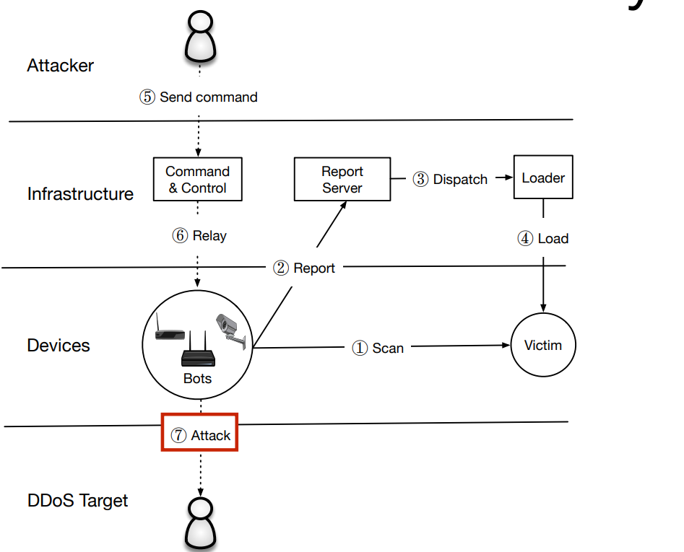
DDoS Botnet of IoT
Mirai Botnet attacked the type of device you looked at in the lab.
Relied on internet facing ports and services (not internal serial ports).
But how would you discover that…

Slide 28
<2nd Slide Interlude>
https://www.usenix.org/sites/default/files/conference/protected-files/usenixsecurity17_slides_ma_zane.pdf
https://itp.cdn.icann.org/en/files/meetings/presentation-intro-to-mirai-espinoza-05nov16-en.pdf

Slide 29
Summary of Properties
Confidentiality: Prevents someone from reading the message, could perhaps still understand from the context
Integrity: Ensures messages has not been modified.
Availability: Ensures service is available for legitimate users.
Non-Repudiation: Guarantee of who sent a message (we’ll look more at this next time).

